Slide 1
PIC16F877A : Timers, Counters and Interrupts
Lecture 6

Slide 2
In this lecture
The difference between Timers and Counters
TMR0 & TMR1 Operations
PIC16F877a Interrupts

Slide 3
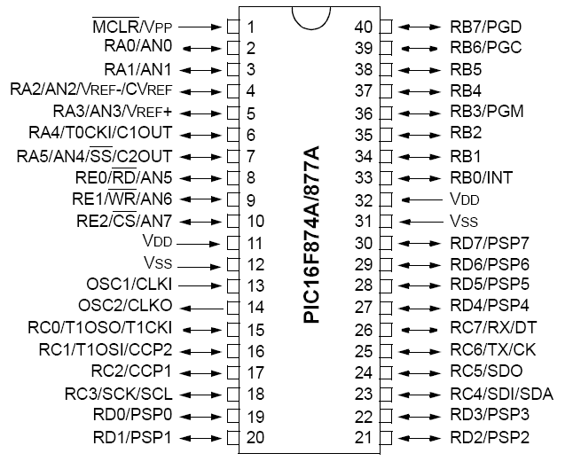

16F877 pin-out
The microcontroller pins have multiple functions

Slide 4
What is a Timer?
Timer is nothing but a simple binary counter that can be configured to count clock pulses(Internal/External).
Once it reaches the Max value, it will roll back to zero setting up an OverFlow flag and generates the interrupt if enabled.
All Timers can act as a timer or counter or PWM Generation

Slide 5
Timer vs. Counters
Timers increment on CPU clock pulses (Keep everything in sync)
Counters increment on external pulses
Other than that, both Timer and Counter operate identically

Slide 6
Timer/Counters
As the name suggests these are used to measure the time or generate the accurate time delay.
The microcontroller can also measure the required time delays by running loops, but the timer relieves the CPU from that redundant and repetitive task, allowing it to allocate maximum processing time for other tasks.

Slide 7
Applications
Timers
  Hardware time delays (MCU are very fast, timers introduces delays)
  Timing how long between events
  Counters
    Electronic turnstiles (Counting how many people passing through)
    Assembly line – counting parts

Slide 8
Timer
General Timer Operation
Capture signal
Capture register
Timer
Overflow/
Timeout
(Interrupt)
Flag
Instruction Clock
Clock
Source
Select
Pre-scaler
(clock divide)
Post-scaler
(output divide)
Binary Counter
External Pulse
Compare register
Match flag
A binary counter is used as a timer when driven from the clock

Slide 9
Pre-scaler
Pre-scaler is a name for the part of a mC which divides oscillator clock before it reaches logic that increases timer status,
Number which divides a clock is defined through first three bits in OPTION Register

Slide 10
PIC Timer/Counters
The PIC 16F877A has three programmable timer/counters
Timer0 is 8-bit timer/counter
Timer1 and Timer2 are 16-bit timer/counters
Watch Dog Timer
Each one has several modes of operation

Slide 11
Timer 0
The Timer0 module timer/counter has the following features:
8-bit timer/counter
Readable and writable
8-bit software programmable pre-scaler
Internal or external clock select
Interrupt on overflow from FFh to 00h
Edge select for external clock

Slide 12
TIMER 0 Registers
OPTION Register
TIMR0 Register
INTCON (Interrupt-Control) Register

Slide 13
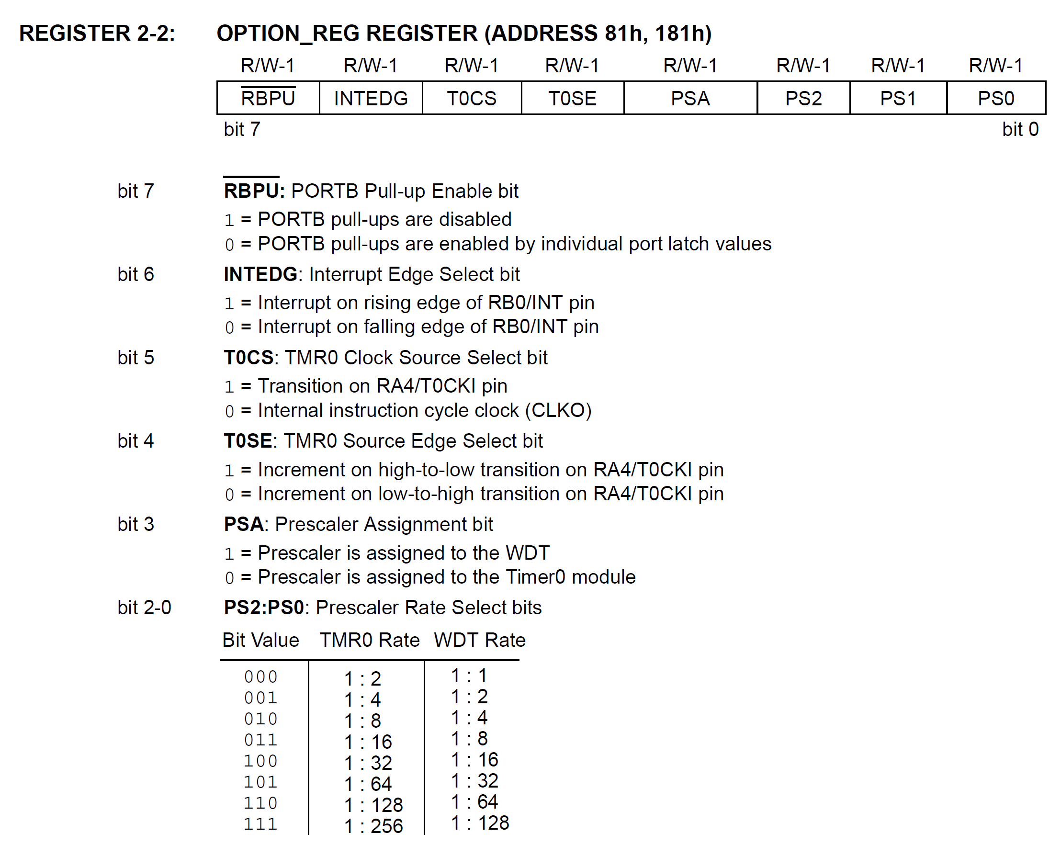
OPTION Register

Slide 14
TIMR0 Register
This Register will hold the Count value.
Wen this register overflows (FF to 00) then an interrupt will be generated.

Slide 15
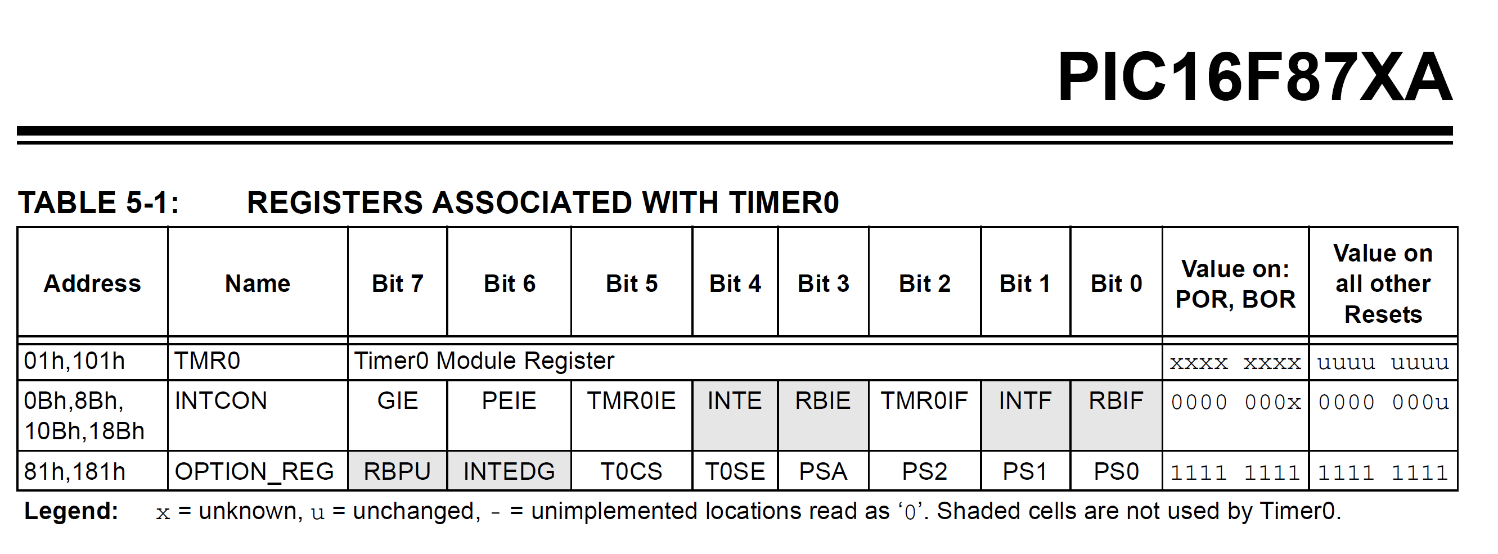

Slide 16
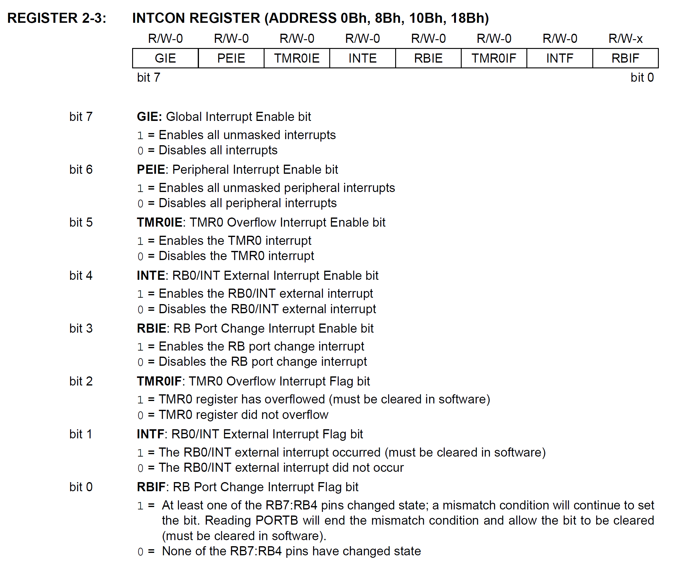
INTCON

Slide 17
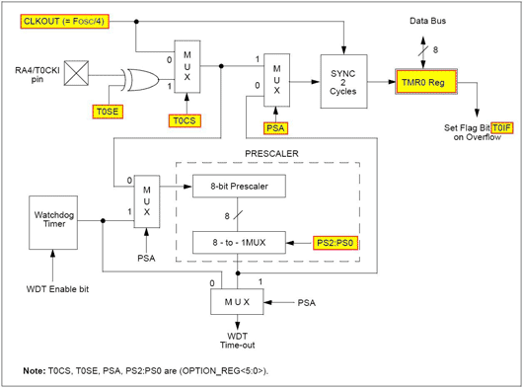
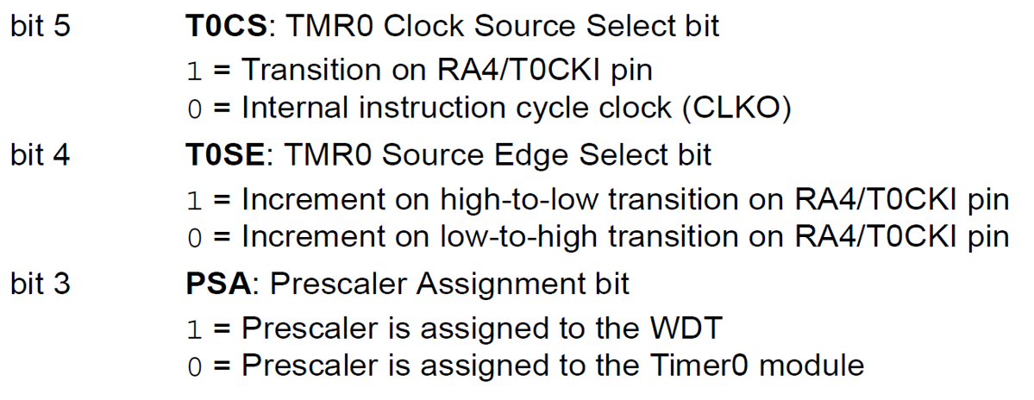
PIC16F877a Timer0 Operation

Slide 18
Timer1
16-bit timer/counter with pre-scaler
Readable and writeable
1,2,4,8 programmable pre-scaler
Internal or external clock select
External clock can be syn. Or asyn.
Interrupt on overflow
Second crystal permitted

Slide 19
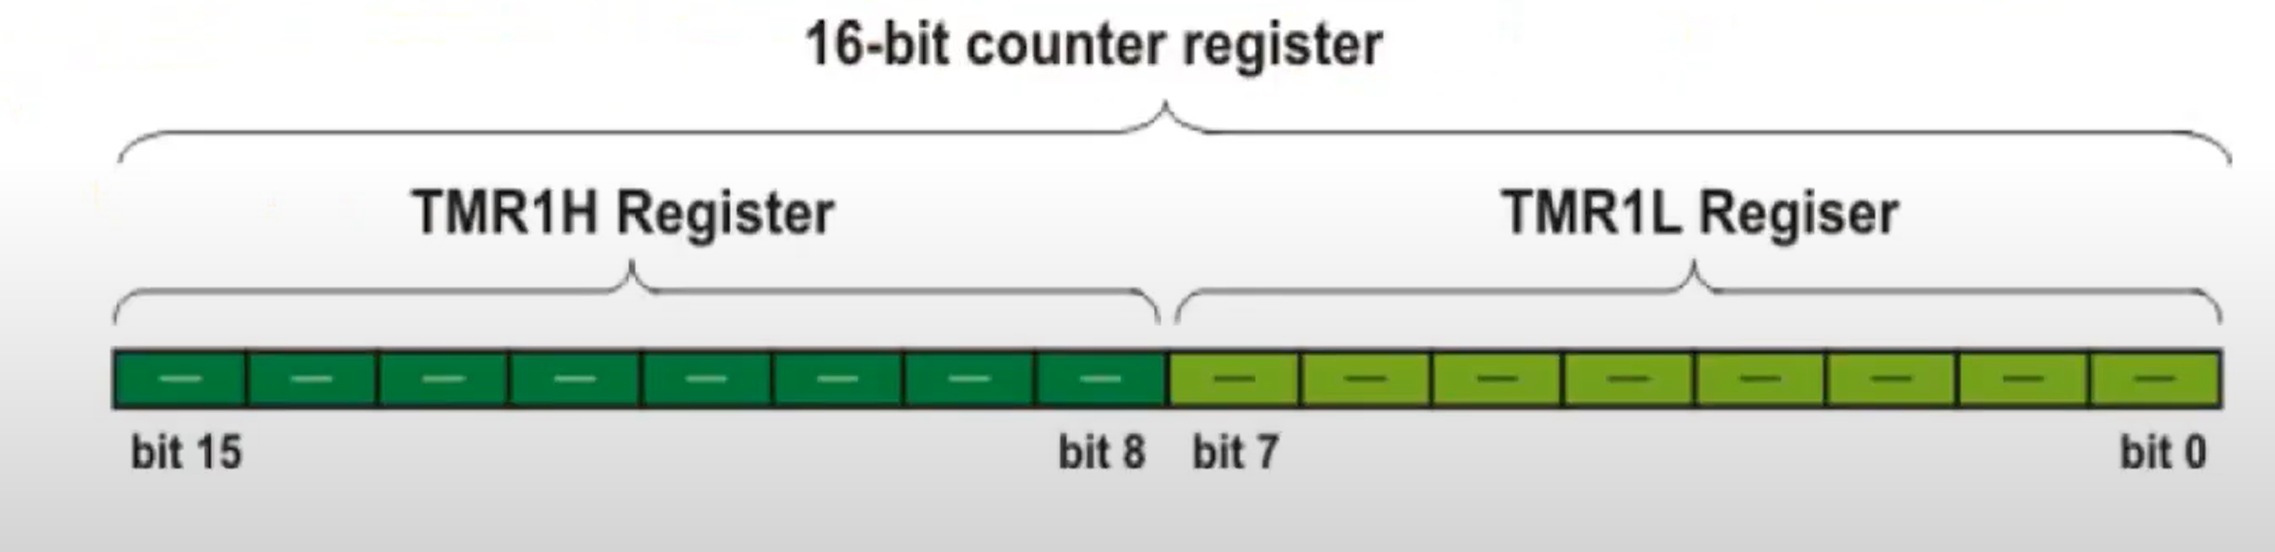
TMR1L and TMR1H
Timer TMR1 module is a 16-bit timer/counter, which means that it consists of two registers (TMR1L and TMR1H). It can count up 65.535 pulses in a single cycle, i.e. before the counting starts from zero.

Slide 20
Timer 1 Registers
TMR1L and TMR1H
T1CON
PIR1
PIE1

Slide 21
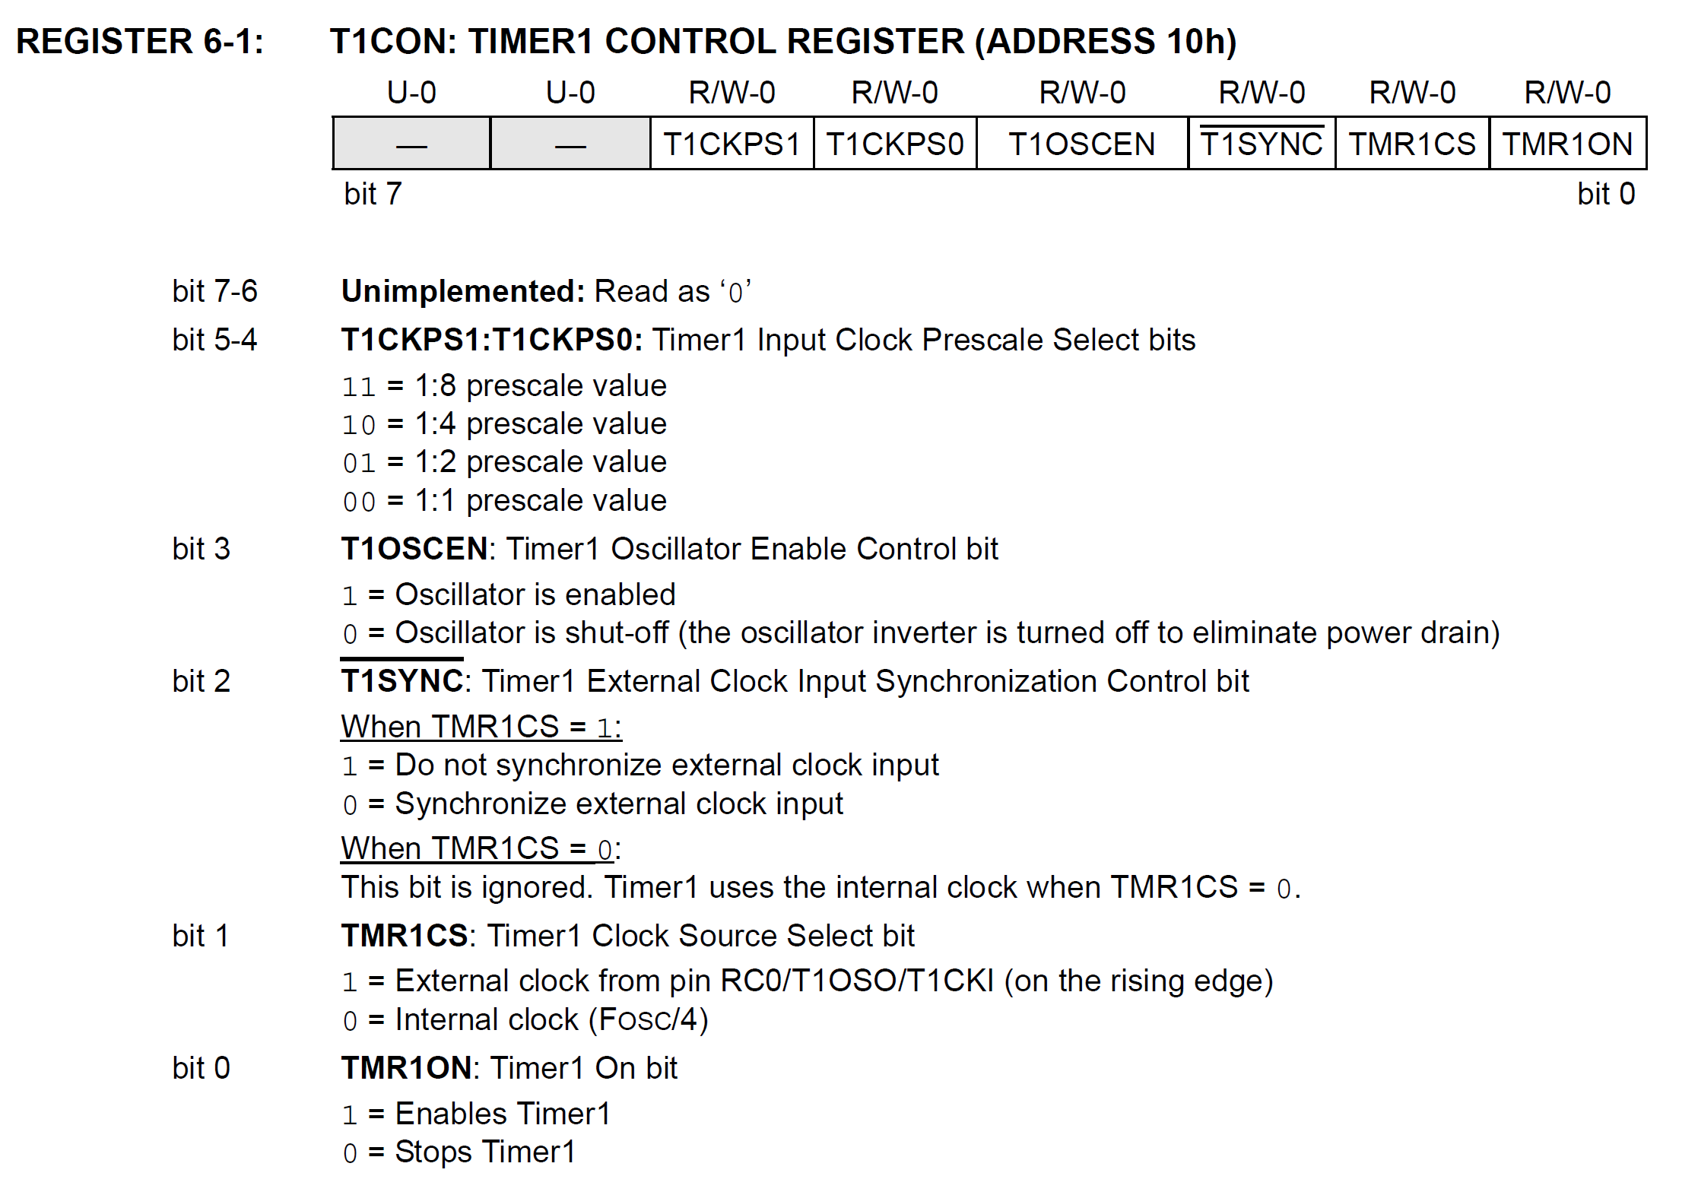
Source https://embeddedlifehelp.blogspot.com/2014/05/delay-function-for-pic16f877a-delay-in.html
Notes:
The T1CON register contains various control bits for the timer 1, like timer/counter, timer gate control, prescaler, timer enable and count enable bits.

Slide 22
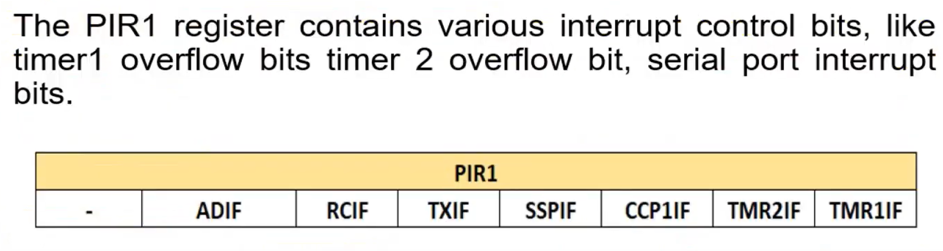
PIR Register

Slide 23
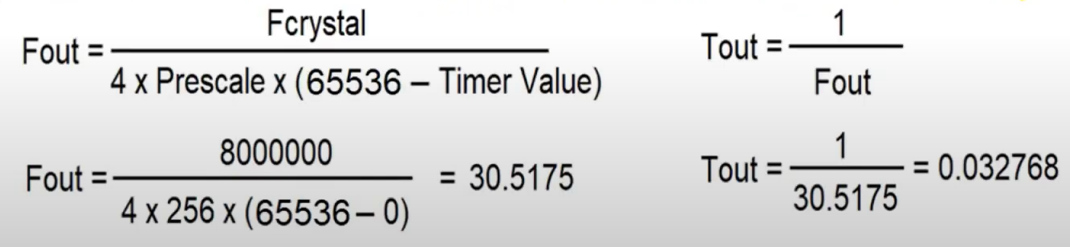
How To Calculate Time Delay
Every timer needs a clock pulse to tick. The clock source can be internal or external. If we use the external clock source, then 1/4th of the frequency of the crystal oscillator on the OSC1 and OSC2 pins(Fosc / 4) is fed into the timer. We have 8MHz crystal 8MHz / 4 = 2 Mis the timer frequency. Clock period T = 1/2MHz = 0.5 us.

Slide 24
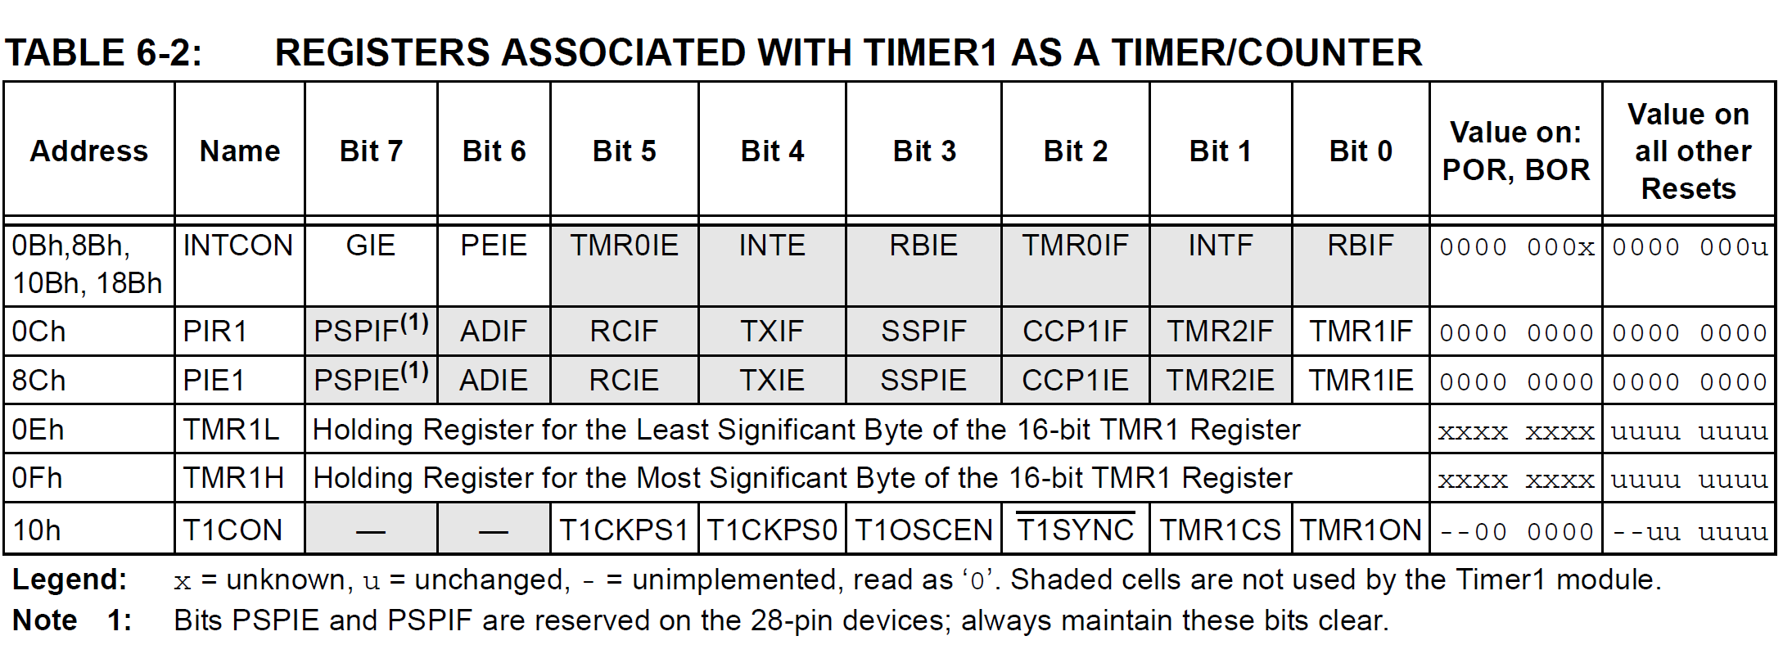

Slide 25
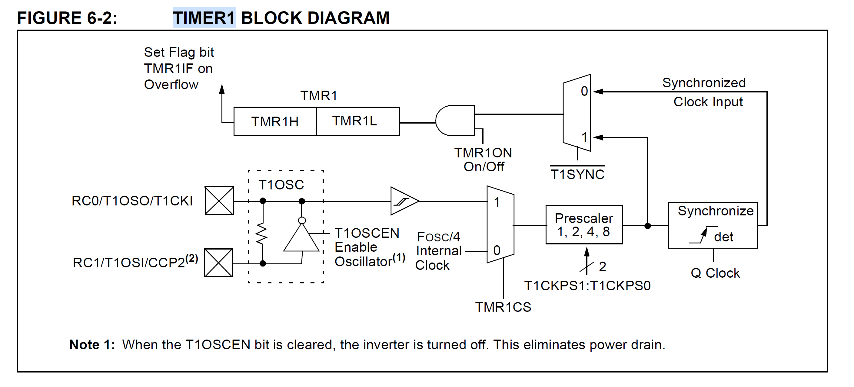

Slide 26
TMR2 Self study https://exploreembedded.com/wiki/PIC16f877a_Timer

Slide 27
Interrupts
Interrupts are mechanisms which enable instant response to events such as counter overflow, pin change, data received, etc.
In normal mode, microcontroller executes the main program as long as there are no occurrences that would cause an interrupt.
Upon interrupt, microcontroller stops the execution of main program and commences the special part of the program(ISR) which will analyze and handle the interrupt.

Slide 28
PIC Polling Vs Interrupt
Polling
    PIC continuously monitors the status of each device
    Each device get the attention of the CPU as the same level of priority
    Wastes u-Controllers time by polling devices that do not need service.
  Interrupt
    Devices get the attention of the CPU only when it needs a service
    Can service many devices with different level of priorities

Slide 29
Interrupt service routine (ISR)
An interrupt is an interesting event which can occur and needs to be handled by a program
Interrupt service routine (ISR) is a function which is automatically executed when an event occurs ( Including, Timer expires, input set to 1, ADC completes, etc)
Main program can continue to execute until the event occurs (No time is wasted)

Slide 30
Interrupt service routine (ISR)
Main program is not aware of the interrupt
Interrupt is invoked by the HW, not the main program
Programmer does not need to worry about triggering the interrupt

Slide 31
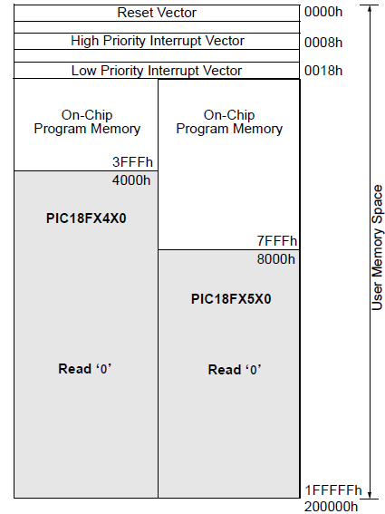
Interrupt service routine (ISR)
When an interrupt is invoked the uC runs the Interrupt Service Routine(ISR)
Interrupt vector table holds the address of ISRs
  Power-on Reset 0000h
  High priority interrupt 0008h
  Low priority interrupt 0018h
11-<number>

Slide 32
Steps in executing an interrupt
Upon activation of interrupt the microcontroller
  Finishes executing the current instruction
  Pushes the PC of next instruction in the stack
  Jumps to the interrupt vector table to get the address of ISR and jumps to it
  Begin executing the ISR instructions to the last instruction of ISR
  Executes RETFIE (RETurn From Interrupt instruction)
    Pops the PC from the stack
    Starts to execute from the address of that PC
Interrupts are grouped into primary and peripheral
Primary interrupt sources are External, PORTChange, and Timer0
11-<number>

Slide 33
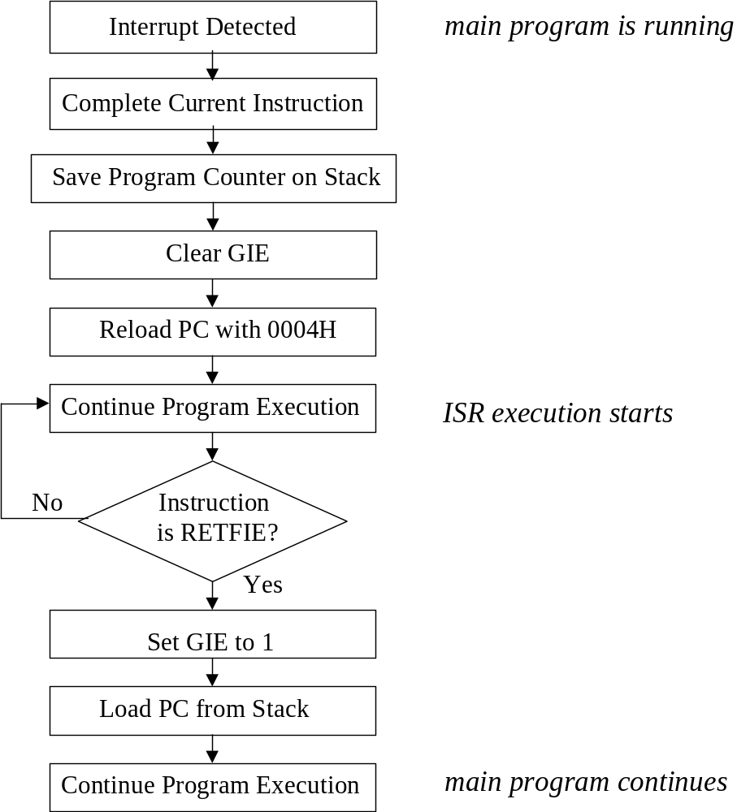
The PIC 16 Series Interrupt Response
Note that this diagram shows what the PIC microcontroller itself does as an interrupt occurs. The programmer need not worry about any of these actions, but needs to know that they’re happening.

Slide 34
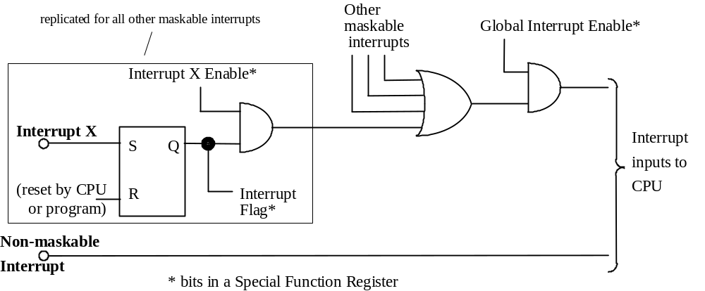
A Generic Interrupt Structure

Slide 35
Interrupts sources in the PIC 16F877
Interrupt Source
Interrupt trigger event
CCS C Interrupt label
TIMERS
Timer 0
Timer 0 register overflow
INT_TIMER0
Timer 1
Timer 1 register overflow
INT_TIMER1
CCP 1
Timer 1 capture or compare detected
INT_CCP1
Timer 2
Timer 2 register overflow
INT_TIMER2
CCP2
Timer 2 capture or compare detected
INT_CCP2
PORTS
RB0/INT pin
Change on single pin RB0
INT_EXT
Port B pins
Change on any of four pins RB4 – RB7
INT_RB
Parallel Slave Port
Data received at PSP (write input active)
INT_PSP
Analog Converter
A/D conversion completed
INT_AD
Analog Comparator
Voltage compare true
INT_COMP
SERIAL
UART Serial Port
Received data available
INT_RDA
UART Serial Port
Transmit data buffer empty
INT_TBE
SPI Serial Port
Data transfer completed (read or write)
INT_SSP
I2C Serial Port
Interface activity detected
INT_SSP
I2C Serial Port
Bus collision detected
INT_BUSCOL
MEMORY
EEPROM
Non-volatile data memory write complete
INT_EEPROM

Slide 36
An Interrupt Review
An Interrupt is an external input to the CPU. The interrupt facility allows the processor to respond rapidly to external changes.
    When an Interrupt is detected by the CPU, it:
      - completes the current instruction,
      - stores the address of the next instruction, and possibly other key variables (e.g. contents of Accumulator and Condition Code Register), onto the stack,
      - jumps to an interrupt service routine (ISR), whose address is determined by an "interrupt vector".
      Many interrupts can be masked, ie disabled, by setting a bit in a control register. In some processors however (but not PIC), some interrupts are not maskable.
      If an Interrupt is masked, then there is a possibility that it will not be detected.
      Therefore there are also Interrupt Flags, bits in SFRs, which are set whenever an associated interrupt occurs. These record the fact that an interrupt has occurred, even if the CPU is unable to respond to it.
      An Interrupt that has occurred, but has not received CPU response, is called a Pending Interrupt.
      In the case of several interrupts, one ISR is completed before the next interrupt is responded to.

